Slide 1
PUT YOUR EDUCATION INTO PRACTICE
INTERNSHIP PROGRAM
with stipend
Join our
LEARNING
PRACTICE
EXPERIENCE
EXPOSURE

Slide 2
FEW OF THE SERVICE DEPARTMENTS/
BRANCHES OF DHA
Transfer & Record Engineering Planning
JV & BOT
Building Control Sales & Marketing Maintenance
Administration & Public Relations Human Resource
Finance Legal Land Projects
Purchase & Procurement Information & Technology Security
Sports Clubs
DHAES (Education System) Medical Services
Telecom
Religious Affairs etc.
DHA represents more than 25% of the charismatic and vibrant part of Lahore. The vigorous 57 branches of DHA Lahore are serving heartedly to celebrate the completeness of ultimate living experience. We continuously strive to extend our matchless amenities & civic facilities whilst ensuring safe and secure living experience to our valued residents.

Slide 3
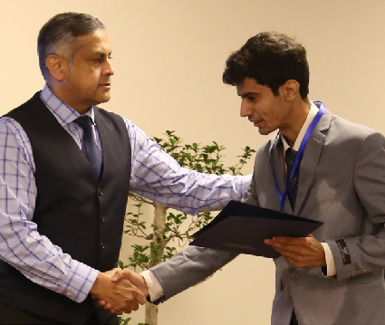
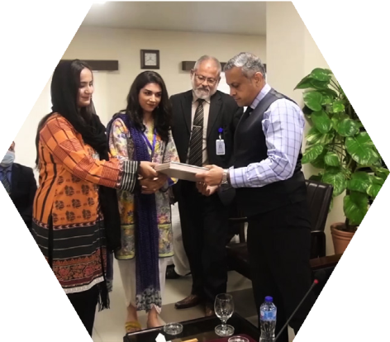
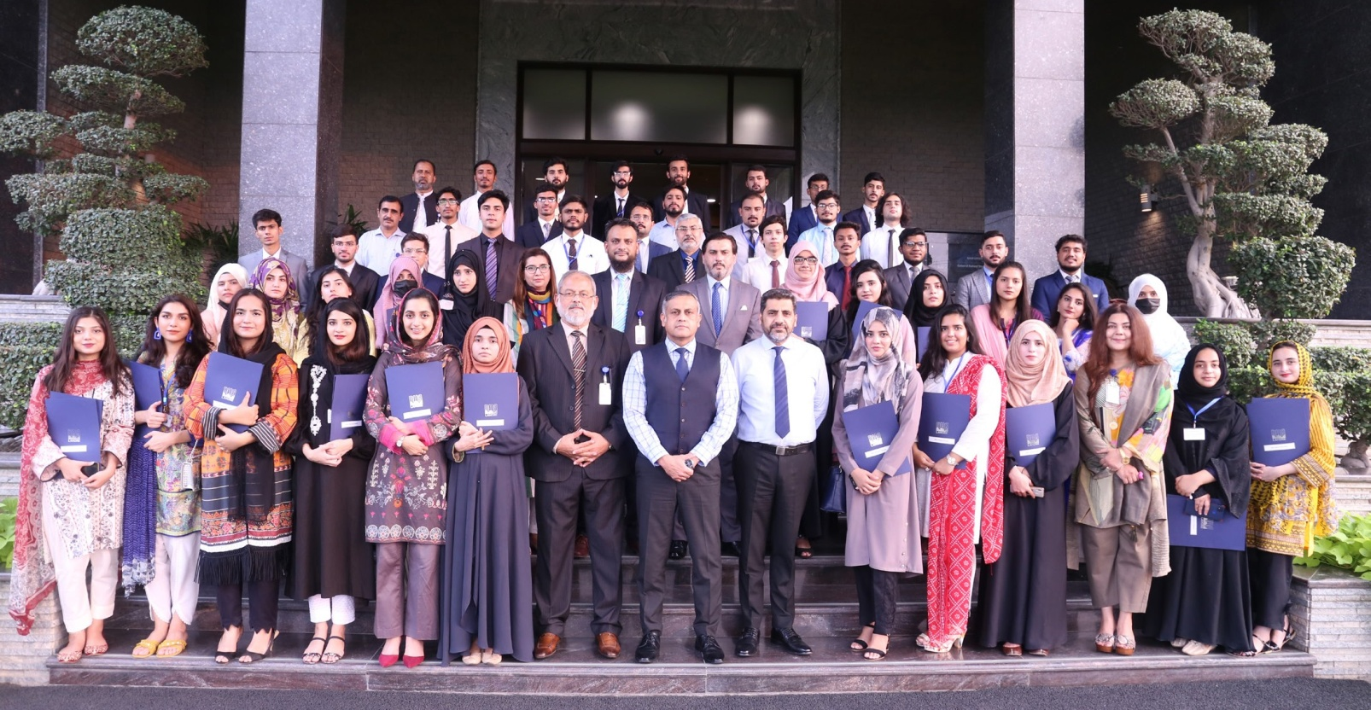
Come & Cherish ‘The Ultimate Living Concept’
INTERNSHIP OFFERED BY DHA LAHORE
DHA Lahore is offering internship opportunity to undergraduates and graduates as one of the corporate social responsibility in line with HEC policy. Number of students from renowned institutions of Pakistan are joining us to avail this chance of practical learning. Internship gives opportunity to develop, explore career and learn new skills. Interns looking to explore the relevant field of their interest are enjoying new learning & experience at various relevant departments (branches) of DHA.
Interaction session of Interns with Administrator DHA Brigadier Waheed Gul Satti.

Slide 4
DHA is holding meaningful and progressive internship program which ensures real life work experience. The study and practice we adopt at our Internship program provides projects insight that will compliment academic program/career interests. Our interns get a broader and holistic exposure to the organisation once assigned the challenging tasks and various kind of functioning related to our projects under reliable and regular mentoring to create a professional network.
S T I P E N D
Under Graduates
Pursuing 16 Years Education
Graduates
16 Years Education
Post Graduates
18 Years Education
Rs. 15,000
per 4 weeks
Rs. 20,000
per 4 weeks
Rs. 25,000
per 4 weeks
100 vacancies with stipend are offered in DHA Lahore each year.

Slide 5
DURATION OF INTERNSHIP
Undergraduate students
(Pursuing 16 yrs degree)
4 to 10 Weeks
(as per time aval to intern / university req)
“An internship provides the work experience that helps students put their education into practice, develop their leadership skills and give them a
Graduate (16 yrs edn)
8 - 10 Weeks
Post graduate (18 yrs edn)
8 - 10 Weeks
competitive advantage as they pursue a permanent position.”
-Lowry
TIMINGS
9 am to 5 pm - Monday - Friday
HOW TO
APPLY
DOCUMENTS REQUIRED FOR INTERNSHIP
University referral letter for undergraduates only (Mentioning Percentage and CGPA of the Student). Attested Photocopy of degree and transcript.
Minimum CGPA required 2.70 (or marks above 67% only for those who have marks system result).
Copy of CNIC (Attested).
3 x Fresh passport size photographs (with blue background). Covering letter (stating duration for which internship required).

Slide 6
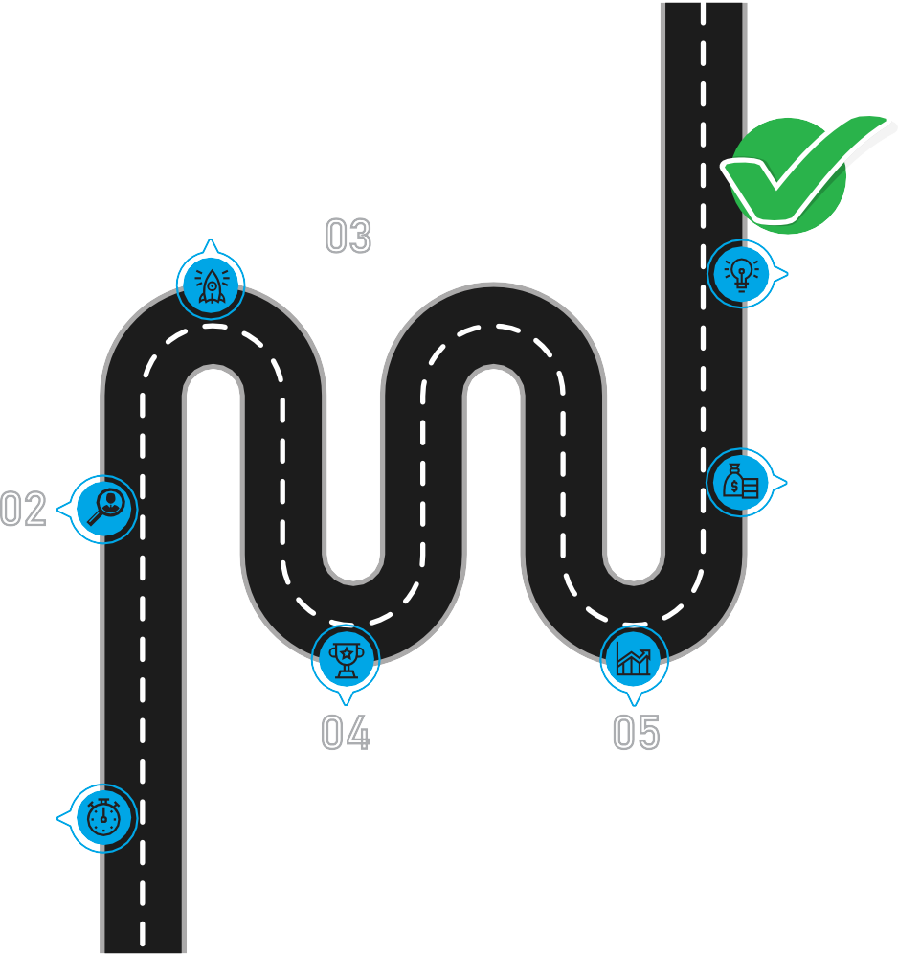
ROADMAP
MTO
Selection
as Intern
Top Performers
hired
In Grade 16
MTO’s
Final Evaluation
After 6 months
Screening Criteria
Min CGPA 2.7
Computer Test
Presentation Interview
Selection as MTO
Top 15 Interns will be
picked
MTO’s
Evaluation
Mid-Term
APPLY
Apply for Internship
Necessary criteria & application forms can be downloaded from DHA website www.dhalahore.org
DEFENCE HOUSING AUTHORITY
Main Office Complex, Sector-A, Phase VI, DHA Lahore UAN: 042 111 342 547
WWW.DHALAHORE.ORG

