Slide 1
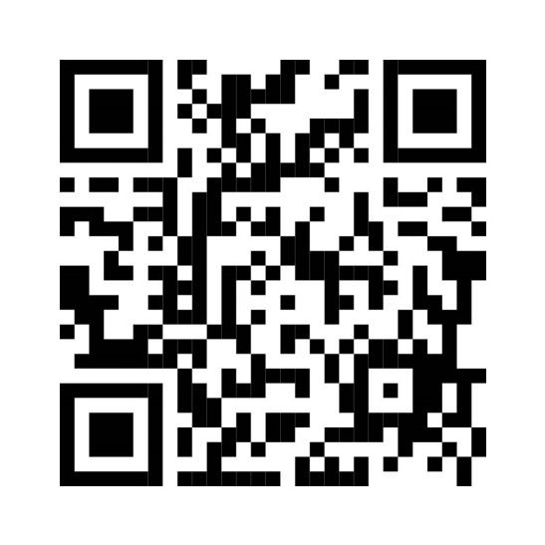
WE ARE
HIRING!
Kaizen Paint Pakistan is a leading provider of high-quality paints and coatings dedicated to innovation and excellence, is seeking motivated and determined individuals to join our team for the following:
POSITION: Technical Trainee Officer
Qualification
Experience
Bachelors in Chemistry, chemical engineering or a relevant field
0-1 year of experience.
Location
Kaizen Paint Pakistan Plant - Sundar Industrial Estate, Lahore.
Overall Responsibilities
The Technical Trainee Officer role involves conducting raw material and paint testing, coordinating projects across internal and external teams, and ensuring timely resolution of technical issues. It includes product development, formula modification, and cost-effective solutions while maintaining lab safety, inventory, and equipment. Evaluating new raw materials and ensuring quality standards are met. Effective documentation and collaboration with various stakeholders are essential for success
Application Deadline: 8th December 2024
Prospective candidates are invited to complete the form by scanning the following QR code
For any queries, please contact on careers.pk@kpme.com
(Kindly mention position title in the subject of the email)
Notes:
https://forms.gle/MrVzMtdzzsZpBwwk9
For any further inquiries please contact on:
careers.pk@kpme.com
(Kindly mention position title in the subject of the email)

